Slide 1

Building Active Directory Lab for Red Teaming

Slide 2

#whoami
👉 Chirag Savla
👉 Twitter – @chiragsavla94
👉 Interest area – Red Teaming, Application Security, Penetration Testing
Blog – https://3xpl01tc0d3r.blogspot.com

Slide 3
Prevention is ideal, detection is a must

Slide 4
What is Active Directory ?
Active Directory is a directory service that centralizes the management of users, computers and other objects within a network. Its primary function is to authenticate and authorize users and computers in a windows domain.

Slide 5
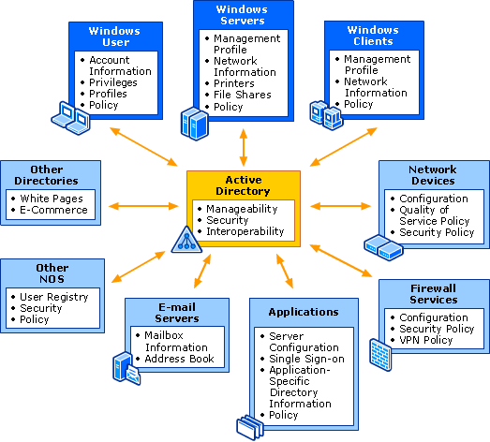
What is Active Directory ?

Slide 6
What is Forest?
= Groups
= Organizational Unit
Domain Forest
= Domain
= Users / Groups
Trust Relationship
rtlabs.local
techno.local
sales.rtlabs.local
accounts.rtlabs.local
dev.techno.local
sec.techno.local
Domain Tree

Slide 7
Active Directory Components
Forest
Domain Trees
Domains
Schema
Objects
Organizational Units (OUs)
Groups
Users
Computer
Sites
Global Catalog (GC)
Group Policy
Domain Trust

Slide 8
Forest
An Active Directory forest (AD forest) is the top most logical container in an Active Directory configuration that contains domains, users, computers, and group policies.

Slide 9
Domain Tree
When you add a child domain to a parent domain you create what is called a domain tree. A domain tree is just a series of domains connected together in a hierarchical fashion all using the same DNS namespace.

Slide 10
Domain
The domain is a logical structure of containers and objects within Active Directory. A domain contains the following components:
A hierarchical structure for users, groups, computers and other objects
Security services that provide authentication and authorization to resources in the domain and other domains
Policies that are applied to users and computers
A DNS name to identify the domain. When you log into a computer that is part of a domain you are logging into the DNS domain name.

Slide 11
Schema
The Active Directory schema defines every object class that can be created and used in an Active Directory forest. It also defines every attribute that can exist in an object. In other words, it is a blueprint of how data can be stored in Active Directory.

Slide 12
Object
Objects are defined as a group of attributes that represent a resource in the domain. These objects are assigned a unique security identifier (SID) that is used to grant or deny the object access to resources in the domain.

Slide 13
Organizational Units (OUs)
An OU is a container object that can contain different objects from the same domain. You will use OUs to store and organize, user accounts, contacts, computers, and groups. You will also link group policy objects to an OU.

Slide 14
Groups
There are two types of objects, a Security group, and a distribution group. A security group is a grouping of users accounts that can be used to provide access to resources. Distribution groups are used for email distribution lists.

Slide 15
Users
A domain user is one whose username and password are stored on a domain controller rather than the computer the user is logging into.
User accounts are used to gain access to the domain resources.

Slide 16
Computer
Each domain‑joined computer has an account in AD DS. Computer accounts are used in the same ways that user accounts are used for users. Each computer has a Security Identification (SID) and attributes. when you create a domain, a Computers container is created.

Slide 17
Sites
A site is a collection of subnets. The Active Directory sites help define the replication flow and resource location for clients such as a domain controller.

Slide 18
Global Catalog (GC)
The global catalog server contains a full replica of all objects and is used to perform forest wide searches. By default the first domain controller in a domain is designated as the GC server.

Slide 19
Group Policy
Group policy allows you to centrally manage user and computer settings. You can use group policy to set password policies, auditing policies, lock screen, map drives, deploy software, one drive, office 365 settings and much more.

Slide 20
Domain Trust
In an AD environment, trust is a relationship between two domains or forests which allows users of one domain or forest to access resources in the other domain or forest.
Trust can be automatic (parent-child, same forest etc.) or established (forest, external).
Trusted Domain Objects (TDOs) represent the trust relationships in a domain.

Slide 21
Domain Trust
In an AD environment, trust is a relationship between two domains or forests which allows users of one domain or forest to access resources in the other domain or forest.
Trust can be automatic (parent-child, same forest etc.) or established (forest, external).
Trusted Domain Objects (TDOs) represent the trust relationships in a domain.

Slide 22
Domain Trust
Trust Direction
One-way trust – Unidirectional. Users in the trusted domain can access resources in the trusting domain but the reverse is not true.
Two-way trust – Bi-directional. Users of both domains can access resources in the other domain.

Slide 23
Domain Trust
Trust Direction
One-way trust – Unidirectional. Users in the trusted domain can access resources in the trusting domain but the reverse is not true.
Two-way trust – Bi-directional. Users of both domains can access resources in the other domain.

Slide 24
Domain Trust
One-way trust
Direction of Access
Direction of Trust
Trust Relationship
rtlabs.local
techno.local

Slide 25
Domain Trust
Two-way trust
Trust Relationship
rtlabs.local
techno.local

Slide 26
Domain Trust
Trust Transitivity
Transitive – Can be extended to establish trust relationships with other domains. All the default intra-forest trust relationships (Tree-root, ParentChild) between domains within a same forest are transitive two-way trusts.
Nontransitive – Cannot be extended to other domains in the forest. Can be two-way or one-way. This is the default trust (called external trust) between two domains in different forests when forests do not have a trust relationship.

Slide 27
Domain Trust
Transitive
Domain A
Domain B
Domain C

Slide 28
Domain Trust
Nontransitive
Domain A
Domain B
Domain C

Slide 29
Domain Trust
Default/Automatic Trusts –
Parent-child trust – It is created automatically between the new domain and the domain that precedes it in the namespace hierarchy, whenever a new domain is added in a tree. For example, sales.rtlabs.local is a child of rtlabs.local. This trust is always two-way transitive.
Tree-root trust – It is created automatically between whenever a new domain tree is added to a forest root. This trust is always two-way transitive.

Slide 30
Domain Trust
Parent-child trust
techno.local
Parent Child Trust
Parent Child Trust
dev.techno.local
sec.techno.local

Slide 31
Domain Trust
Tree-root trust
Parent Child Trust
techno.local
dev.techno.local
sec.techno.local
Tree-root trust
Parent Child Trust
sec.rtcloud.local
aws.sec.rtcloud.local

Slide 32
Domain Trust
Shortcut Trusts – Used to reduce access times in complex trust scenarios. Can be one-way or two-way transitive.
External Trusts – Between two domains in different forests when forests do not have a trust relationship. Can be one-way or two-way and is nontransitive.
Forest Trusts – Between forest root domain. Cannot be extended to a third forest (no implicit trust). Can be one-way or two-way and transitive or nontransitive.

Slide 33
Domain Trust
Shortcut Trusts
Parent Child Trust
techno.local
dev.techno.local
sec.techno.local
Tree-root trust
Shortcut Trust
Parent Child Trust
sec.rtcloud.local
aws.sec.rtcloud.local

Slide 34
Domain Trust
External Trusts
Parent Child Trust
Parent Child Trust
techno.local
Parent Child Trust
rtlabs.local
One-Way External Trust
sales.rtlabs.local
accounts.rtlabs.local
Two-Way External Trust
sec.techno.local

Slide 35
Domain Trust
Forest Trusts
Forest trust
Forest trust
rtlabs.local
techno.local
consult.local

Slide 36
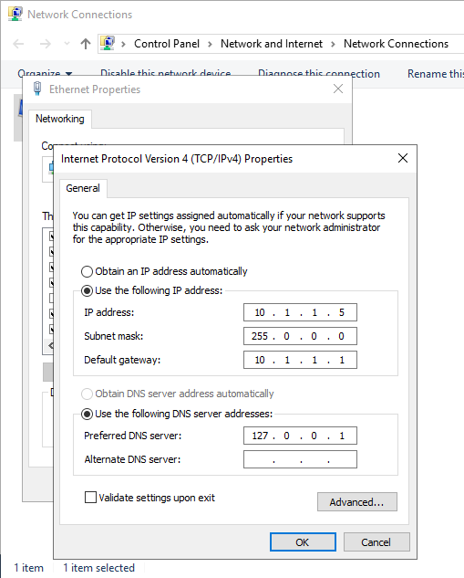
Setup Active Directory

Slide 37
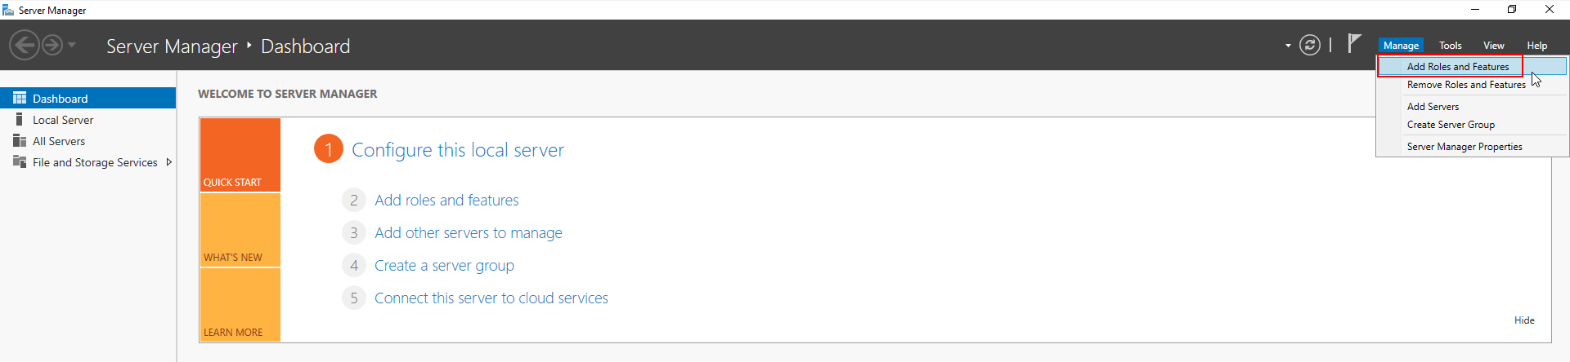
Setup Active Directory

Slide 38
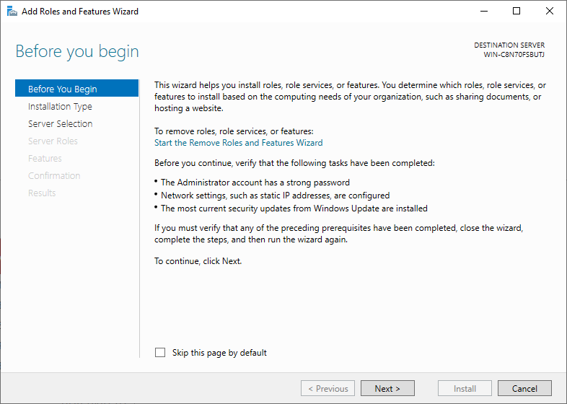
Setup Active Directory

Slide 39
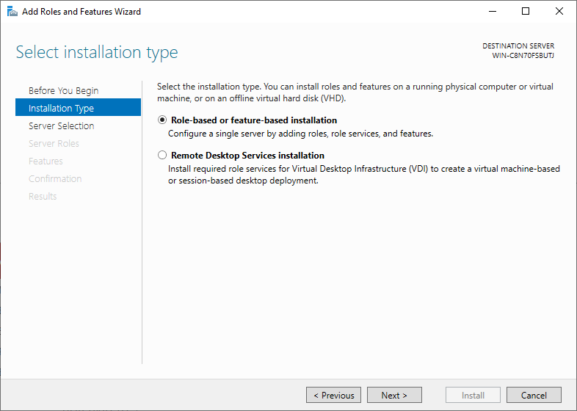
Setup Active Directory

Slide 40
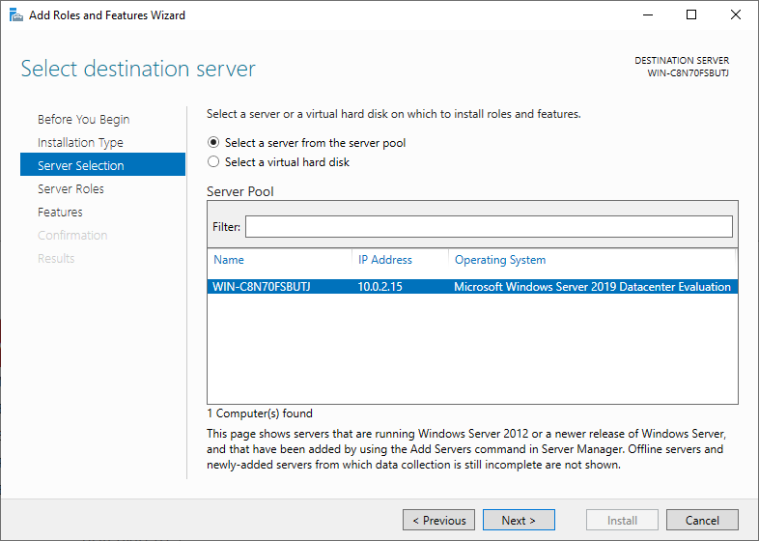
Setup Active Directory

Slide 41
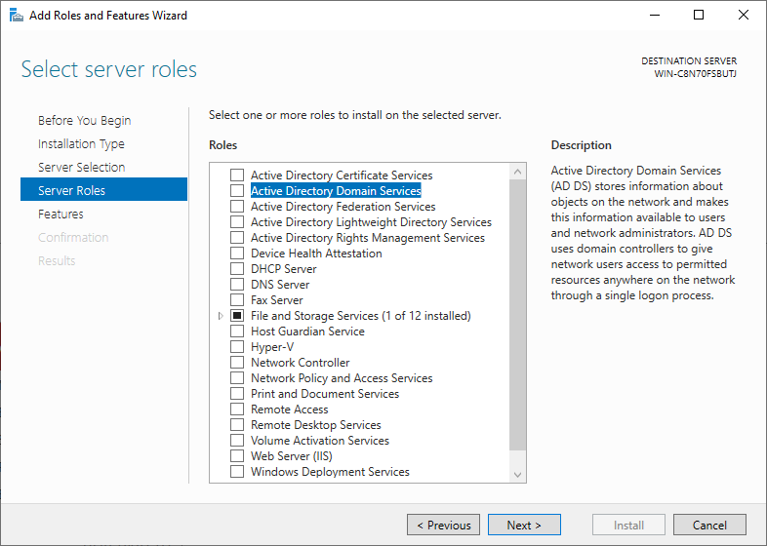
Setup Active Directory

Slide 42
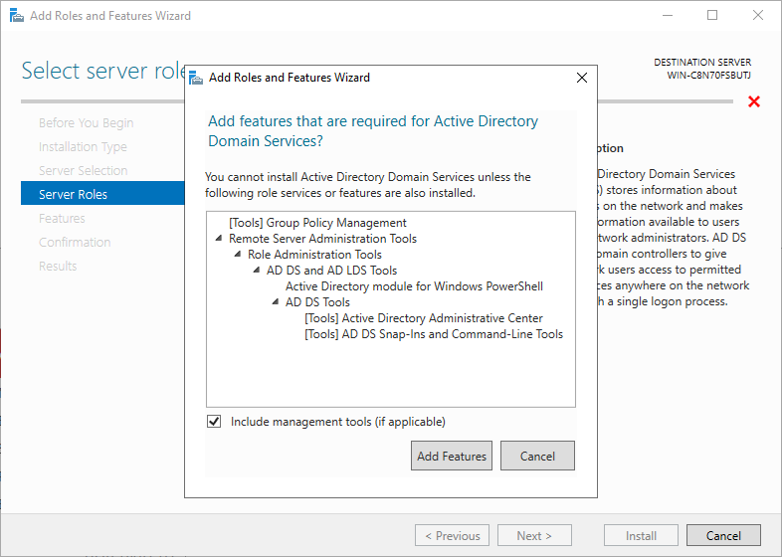
Setup Active Directory

Slide 43
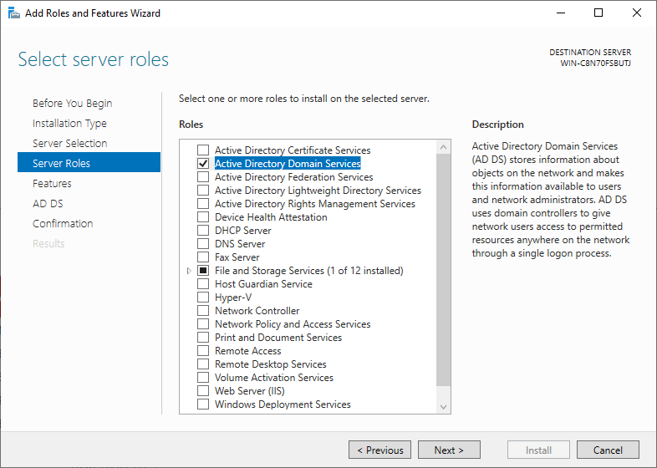
Setup Active Directory

Slide 44
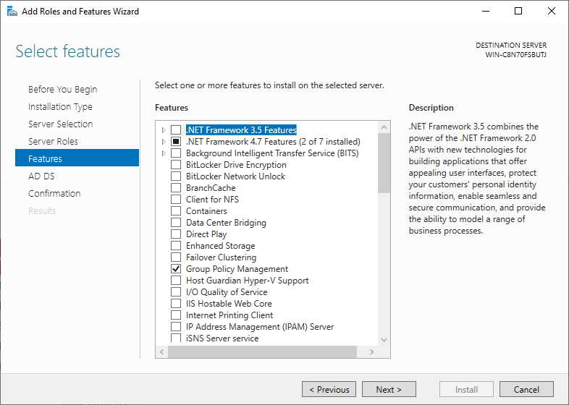
Setup Active Directory

Slide 45
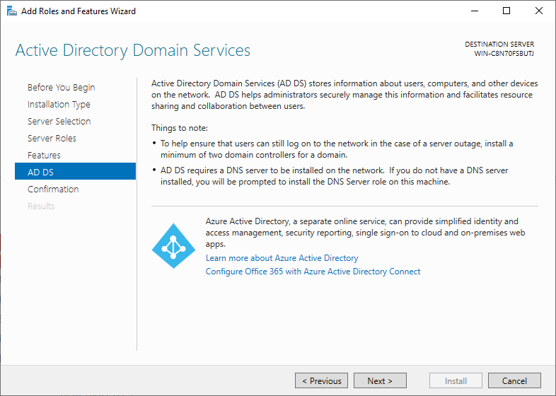
Setup Active Directory

Slide 46
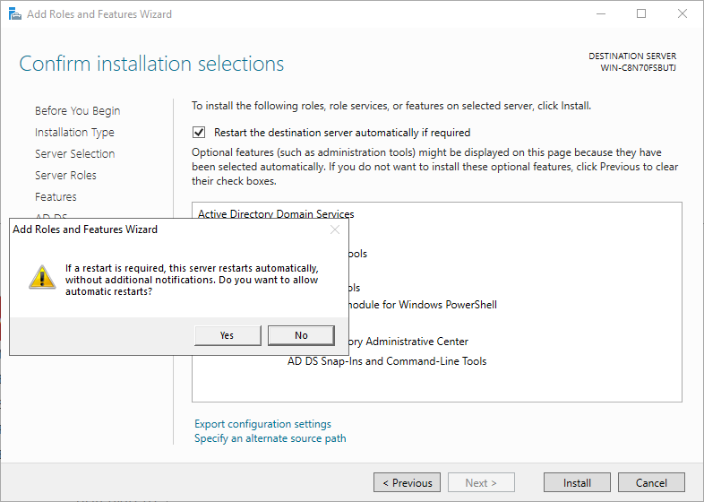
Setup Active Directory

Slide 47
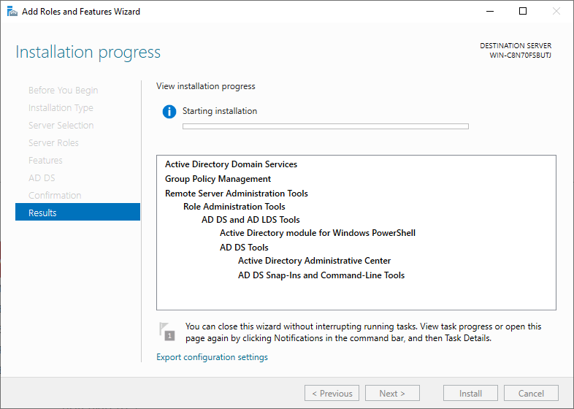
Setup Active Directory

Slide 48
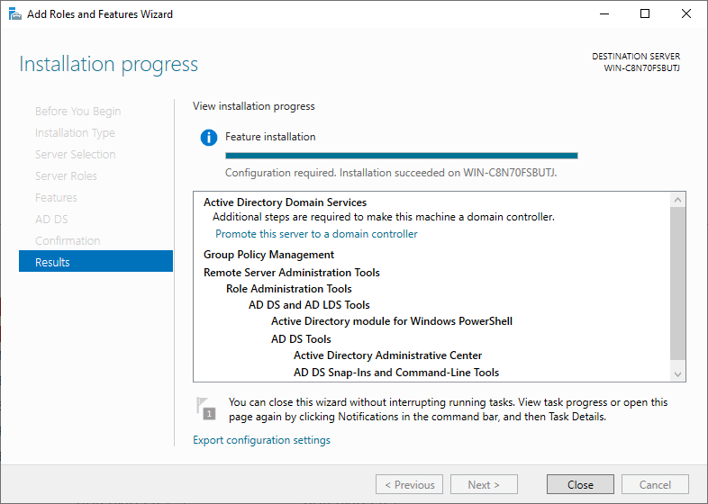
Setup Active Directory

Slide 49
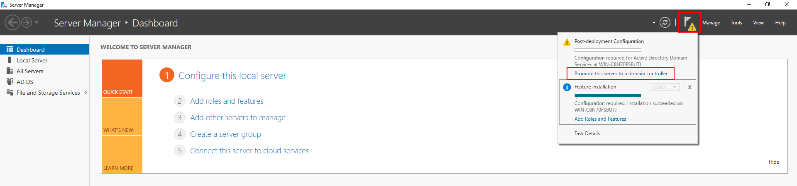
Setup Active Directory

Slide 50
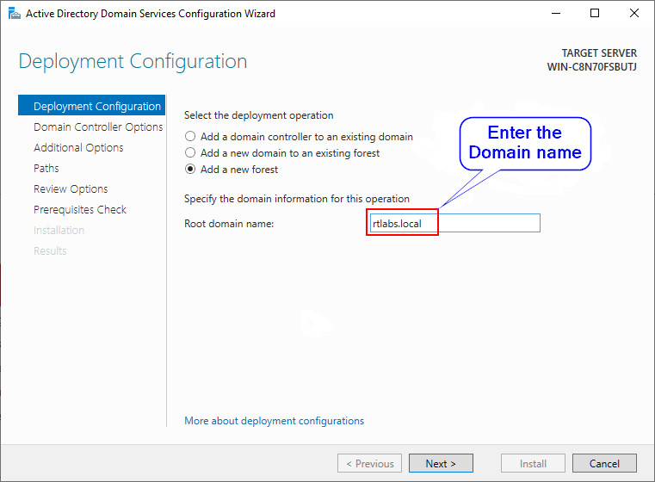
Setup Active Directory

Slide 51
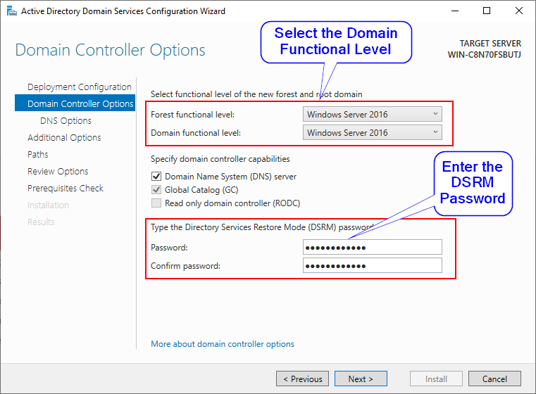
Setup Active Directory

Slide 52
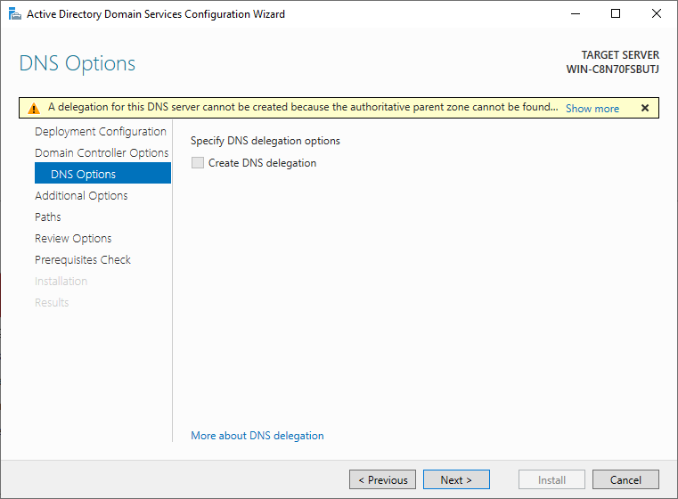
Setup Active Directory

Slide 53
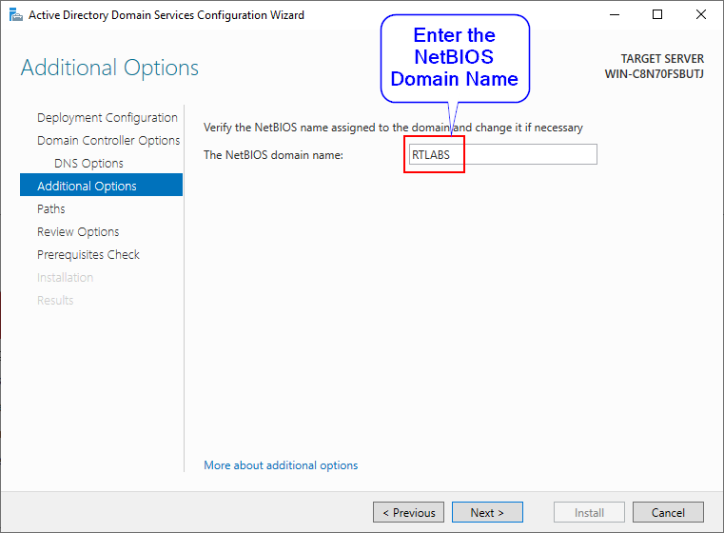
Setup Active Directory

Slide 54
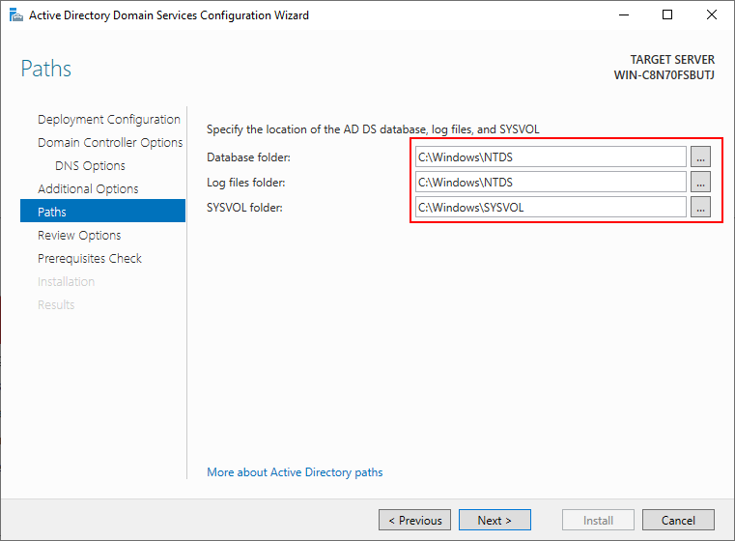
Setup Active Directory

Slide 55
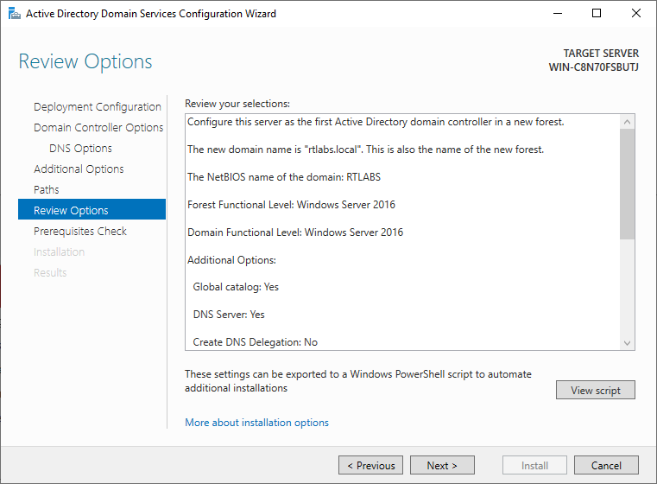
Setup Active Directory

Slide 56
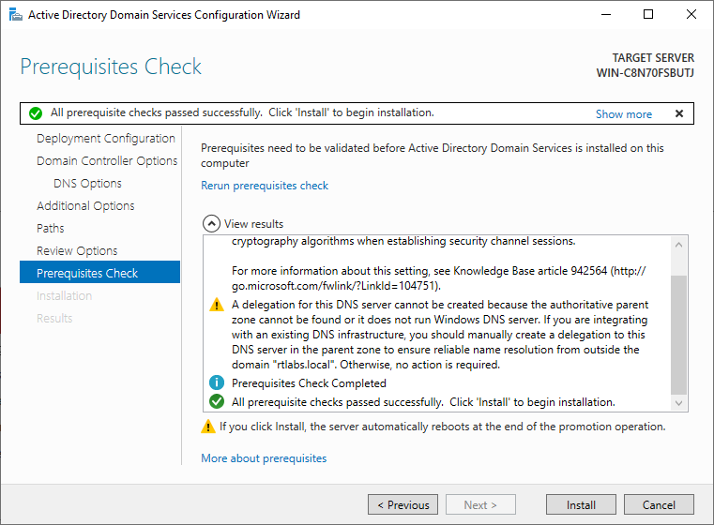
Setup Active Directory

Slide 57
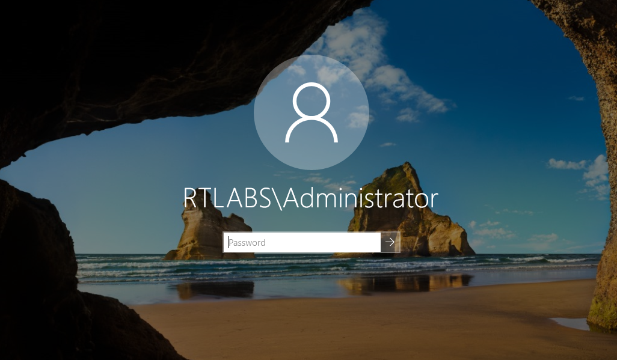
Setup Active Directory

Slide 58
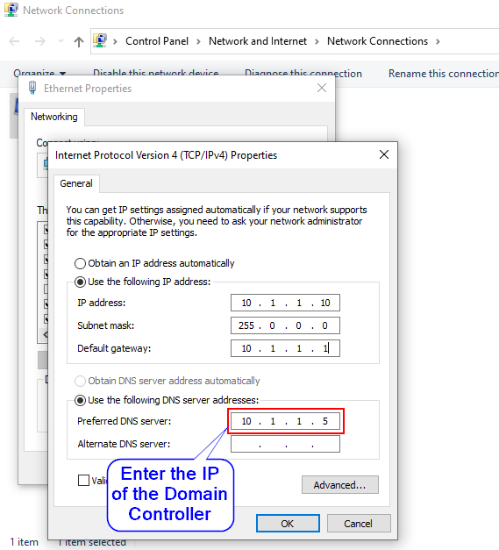
Integrate Client Machine

Slide 59
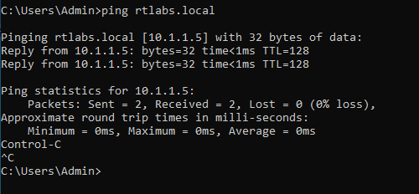
Integrate Client Machine

Slide 60
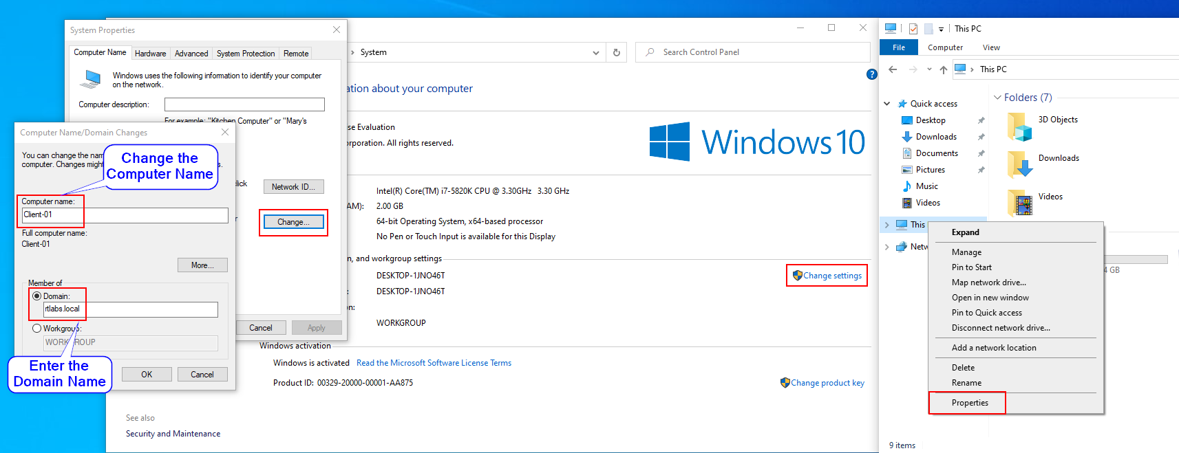
Integrate Client Machine

Slide 61
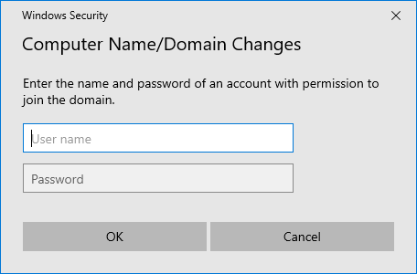
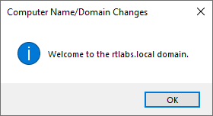
Integrate Client Machine

Slide 62
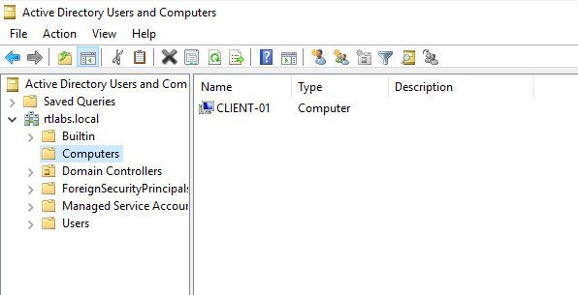
Integrate Client Machine

Slide 63
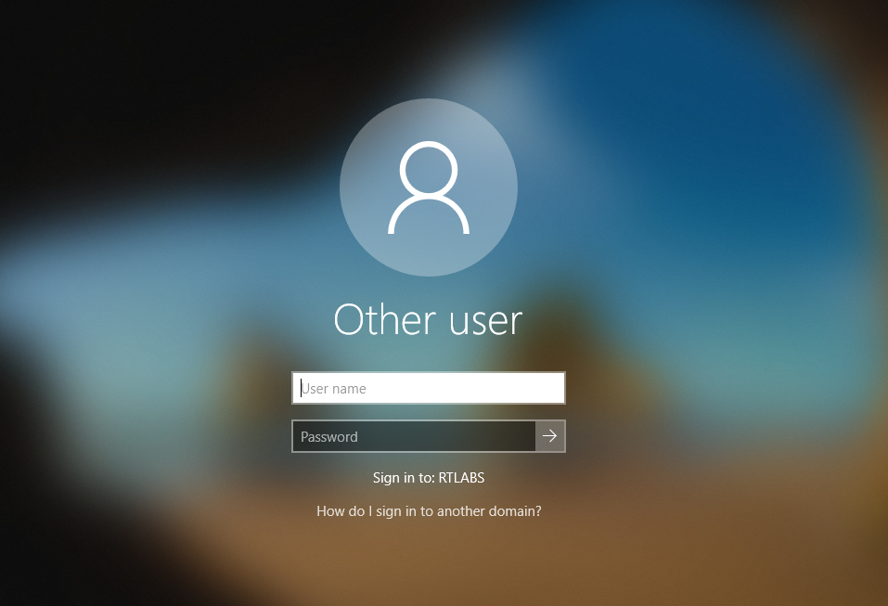
Integrate Client Machine

Slide 64
Credits
Thanks to @NullMumbai for granting me the privilege to present.

Slide 65
Reference
https://docs.microsoft.com/en-us/previous-versions/windows/it-pro/windows-server-2003/cc780036(v=ws.10)
https://docs.microsoft.com/en-us/previous-versions/windows/it-pro/windows-server-2003/cc773178(v=ws.10)
https://activedirectorypro.com/glossary/
https://adsecurity.org/

Slide 66
THANKS!
Any questions?
You can find me at @chiragsavla94

